Slide 1
Minnesota license plate photo decode and auto data lookup
Final Project – Team 9
Nick Prentkowski
Jon Simpson
Ben Farniok
Terrence Cummings

Slide 2
Our story
Ever been walking down the street, saw a nice car but weren’t sure of the make, model, and year?
Have a used car sales website and want to give your users the capability to auto-complete their car data with simply a photo of their license plate?
Now just snap a photo of the license plate and upload it to the ”Minnesota License Plate Decoder”.
Our machine learning algorithm will extract the license plate number and lookup the make, model, and year of the auto based on the VIN associated with the license plate number.

Slide 3
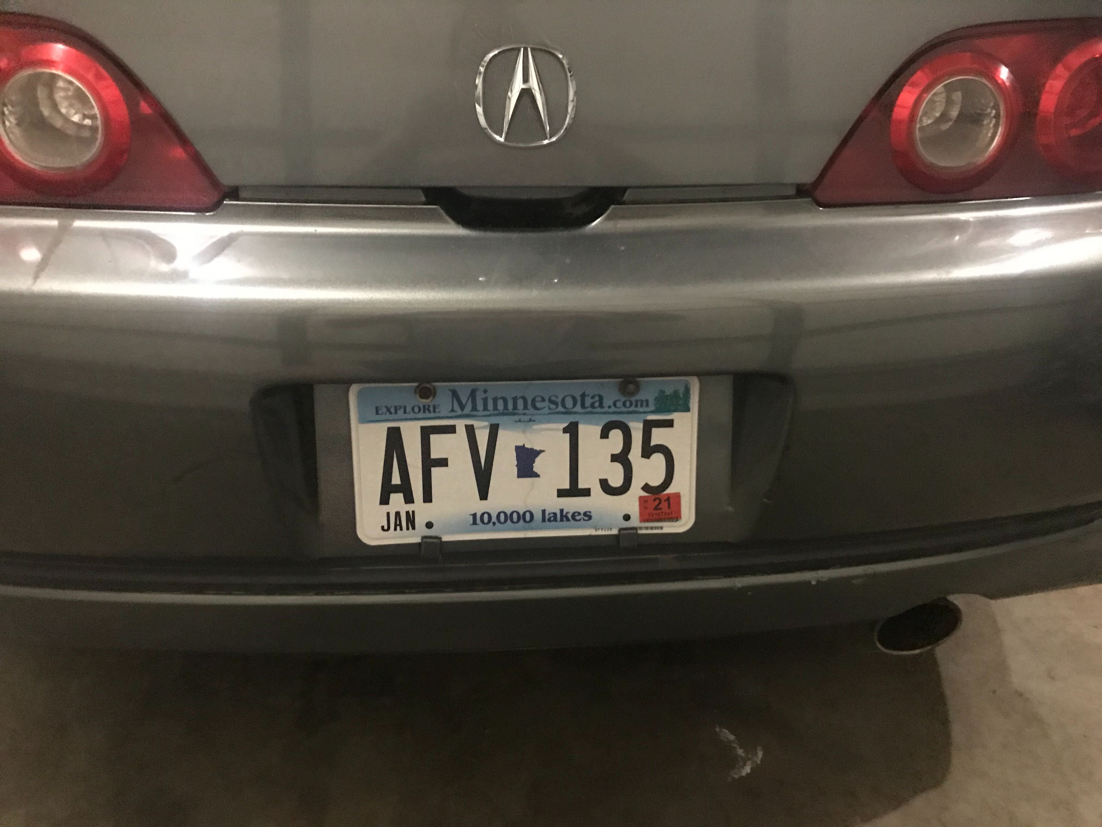



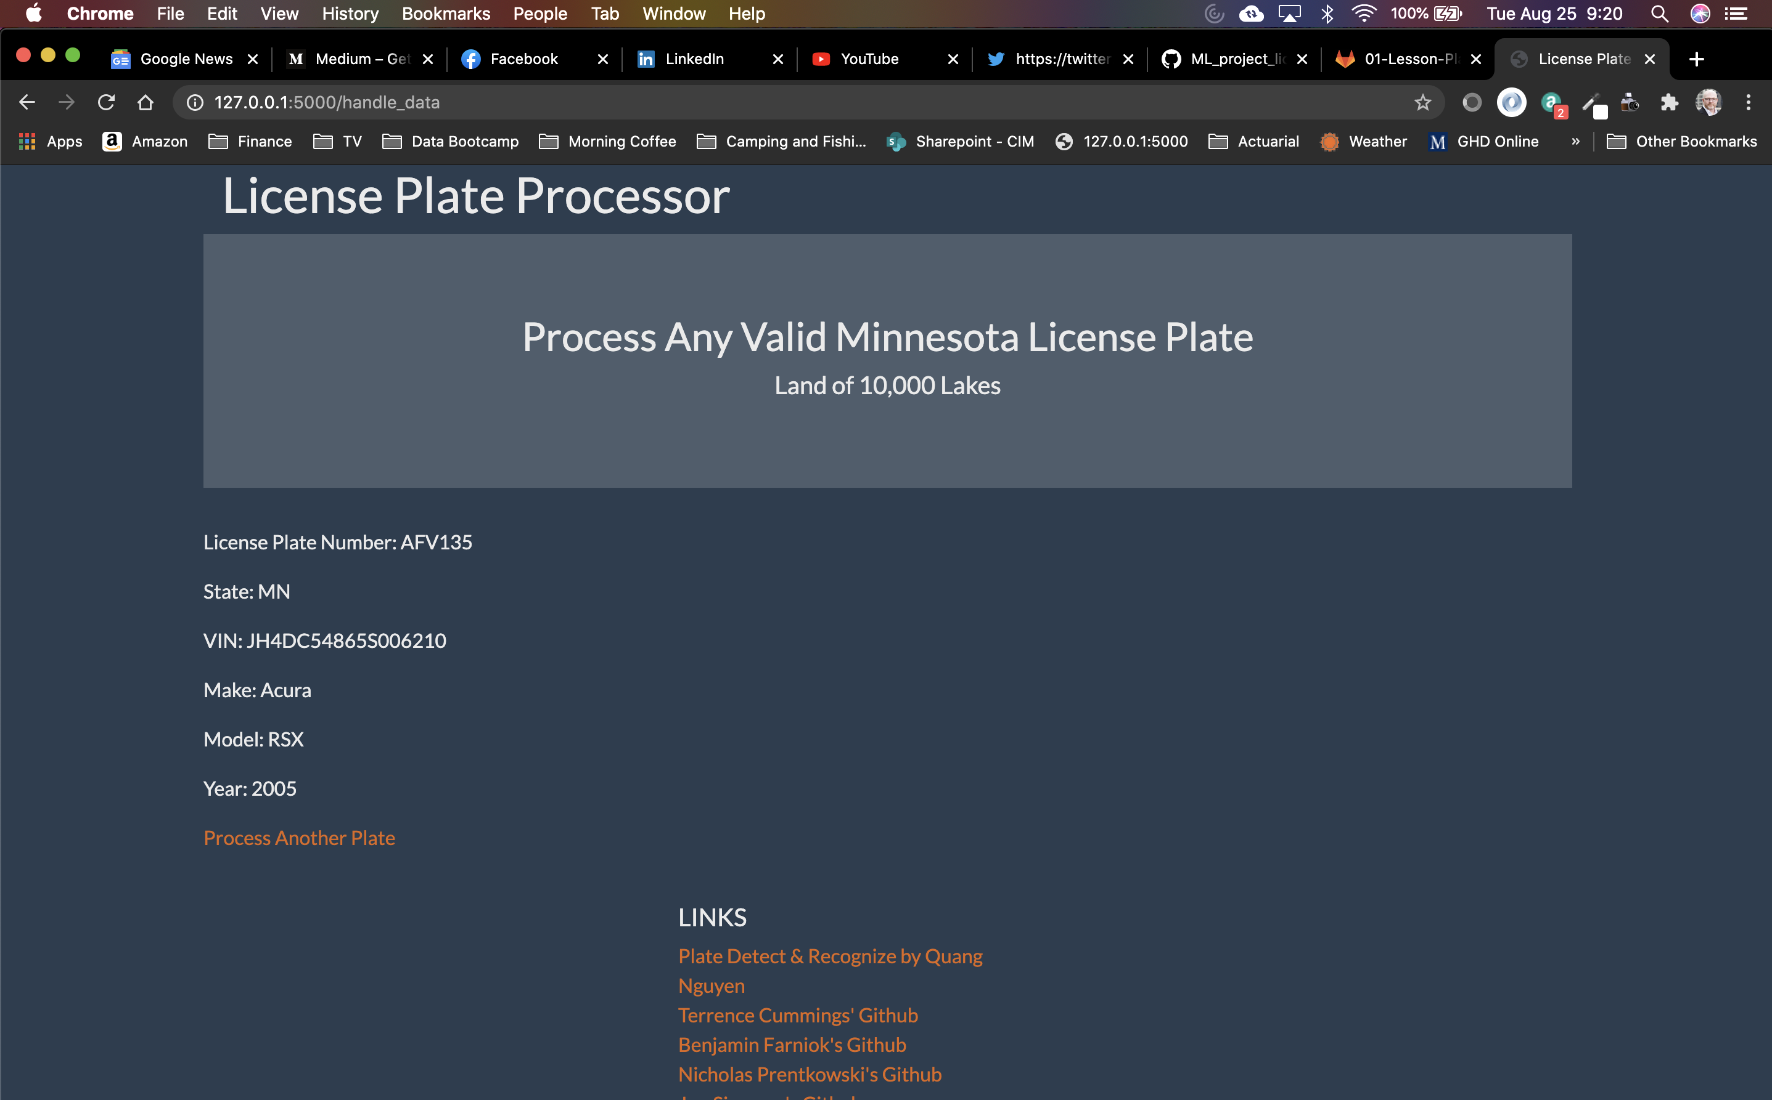

Technology and architecture
Technologies used:
Python
Flask
Pandas
Matplotlib
Numpy
Keras
Tensorflow
OpenCV
HTML/CSS
Image upload
License photo upload
Styling, UI
ML plate number extraction
API call w/ license plate #
Output
https://vincheck.info/free-license-plate-lookup
Auto make, model, year

